Slide 1

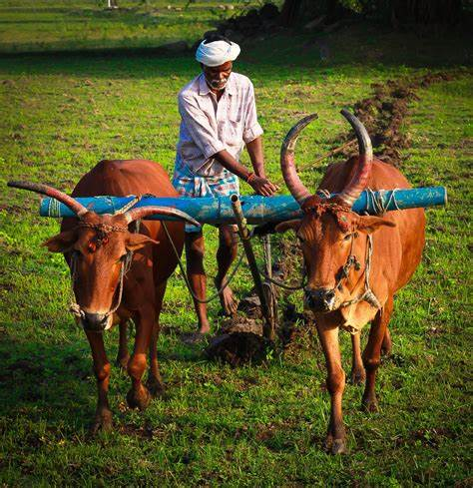
Ayush Bari
Crop Disease Prediction Using CNNs
This presentation explores the exciting world of crop disease prediction using Convolutional Neural Networks (CNNs). CNNs are a powerful tool for image analysis, enabling us to accurately identify plant diseases from visual data.

Slide 2
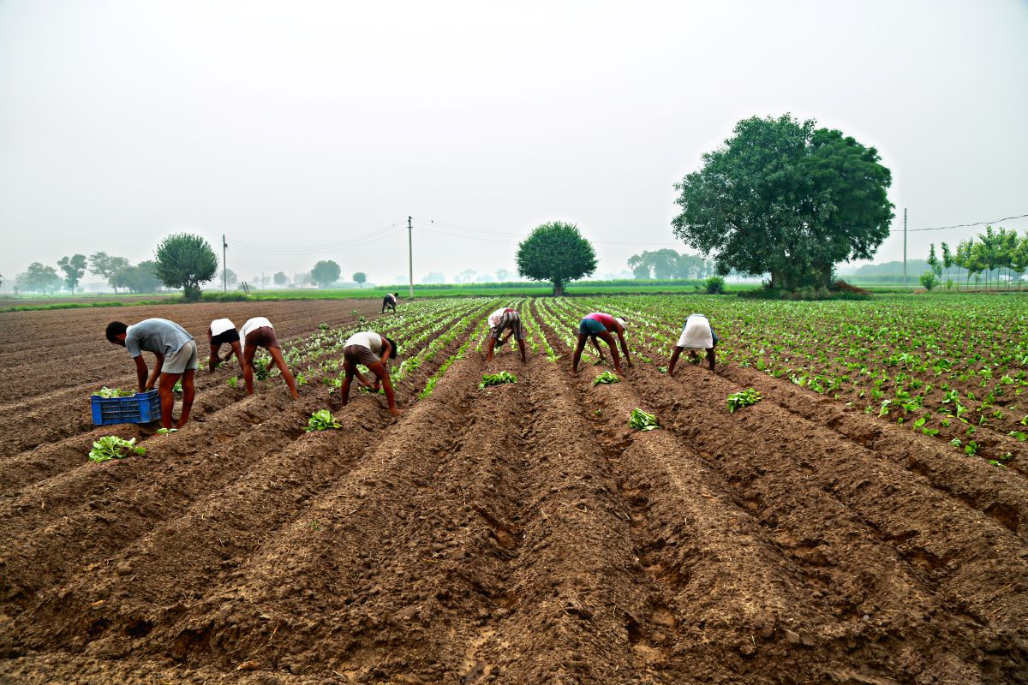
Importance of Crop Disease Identification
Prompt disease detection is crucial for ensuring optimal crop yield and minimizing economic losses. Early intervention through accurate diagnosis can save entire harvests and ensure food security.
1
Yield Protection
2
Economic Sustainability
Preventing widespread outbreaks safeguards crop productivity.
Minimizing losses ensures profitability for farmers and the agricultural industry.
3
Food Security
4
Environmental Impact
Healthy crops contribute to a stable food supply for populations worldwide.
Sustainable farming practices minimize the use of pesticides and fertilizers.

Slide 3
Idea/Approach Details
Our approach combines the power of CNNs with a user-friendly interface to provide farmers with a reliable tool for early disease detection.
Product Status
Technology Stack
Architecture
The system is currently in the development phase, with a focus on robust model training and comprehensive data collection.
We leverage Python, TensorFlow, and Keras for model development, along with cloud-based services for data storage and deployment.
The system comprises a data acquisition module, a CNN model, and a user-friendly interface for displaying predictions.

Slide 4
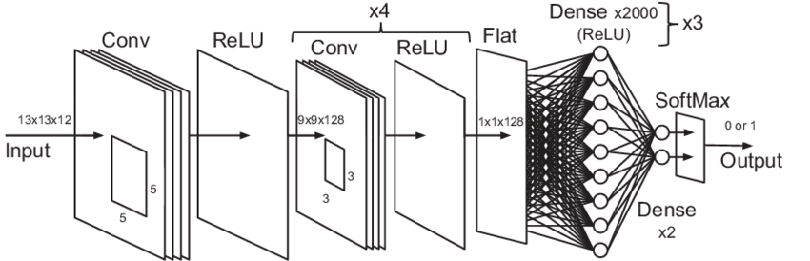
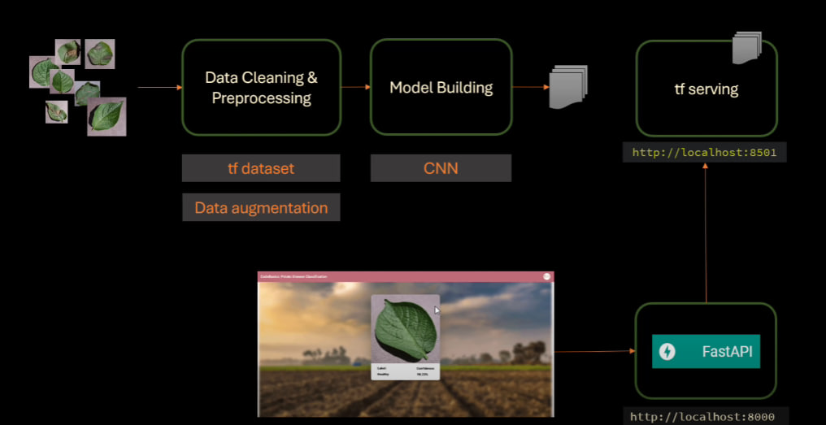
Overview of Convolutional Neural Networks (CNNs)
CNNs are a type of artificial neural network designed for image recognition. They excel at capturing spatial patterns and features within images, making them ideal for analyzing plant diseases.
Convolutional Layers
Pooling Layers
These layers extract features by sliding filters over the image, identifying patterns like edges and textures.
They downsample the feature maps, reducing computational complexity and extracting the most important features.
Fully Connected Layers
These layers combine features learned in previous layers to classify the image as diseased or healthy.

Slide 5
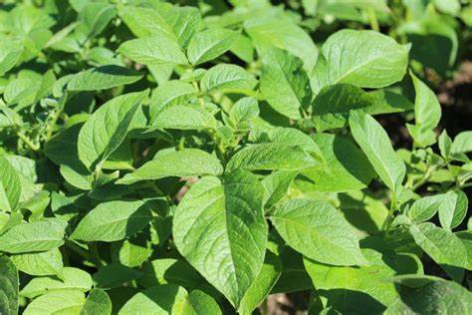
Data Collection and Preprocessing
High-quality data is essential for training a robust CNN model. We collect a comprehensive dataset of plant images with various diseases and healthy controls.
1
Image Acquisition
We collect images from various sources, including public databases, field surveys, and user contributions.
2
Data Labeling
Each image is meticulously labeled with the corresponding disease or healthy status, ensuring accurate model training.
3
Preprocessing
The images are resized, normalized, and augmented to improve model performance and prevent overfitting.

Slide 6
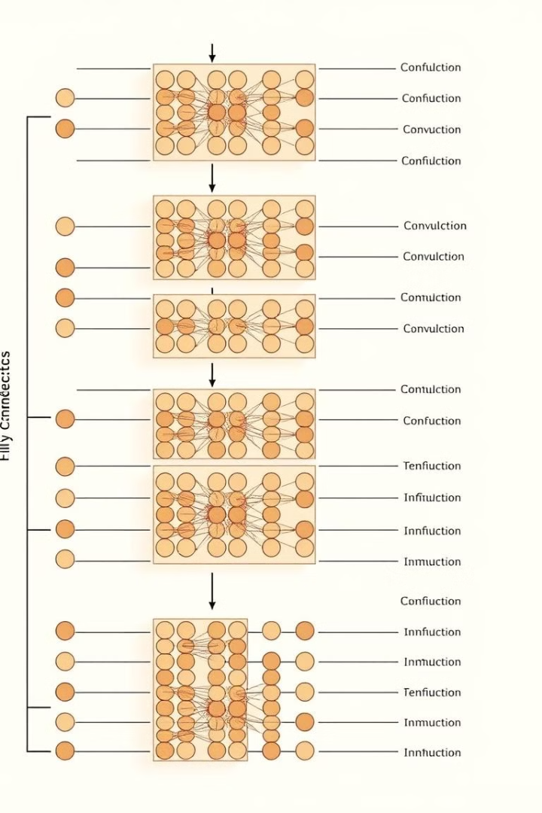
CNN Architecture Design
The architecture of the CNN model is crucial for its accuracy and performance. We carefully design the network to optimize feature extraction and classification.
Layer Type
Description
Purpose
Convolutional
Extract features like edges, textures, and shapes from the image.
Identify disease-specific patterns.
Pooling
Downsample the feature maps, reducing computational complexity.
Improve robustness and reduce overfitting.
Fully Connected
Combine learned features for classification.
Predict the disease status of the plant.

Slide 7
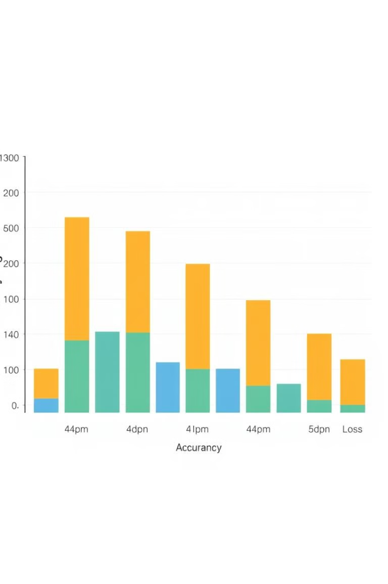



Model Training and Validation
The CNN model is trained using the collected dataset, iteratively adjusting its parameters to minimize errors and achieve high accuracy.
Training Data
The model learns from the labeled images, optimizing its ability to identify diseased plants.
Validation Data
The model's performance is evaluated on a separate set of images to assess its generalization ability.
Hyperparameter Tuning
We fine-tune the model's parameters, such as learning rate and network size, to achieve optimal performance.

Slide 8




Deployment and Real-Time Prediction
Once trained, the CNN model is deployed on a platform that allows real-time prediction of plant diseases from user-uploaded images.
Image Capture
Cloud-Based Processing
Real-Time Feedback
Farmers can capture images of their plants using their smartphones or cameras.
The images are uploaded to the cloud platform, where the trained CNN model performs the prediction.
The system provides immediate results, enabling farmers to take timely actions based on the prediction.

Slide 9
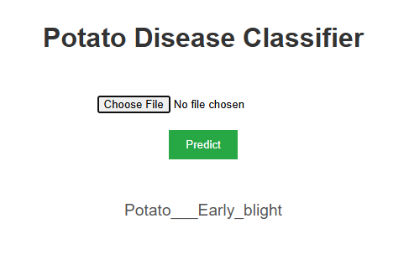
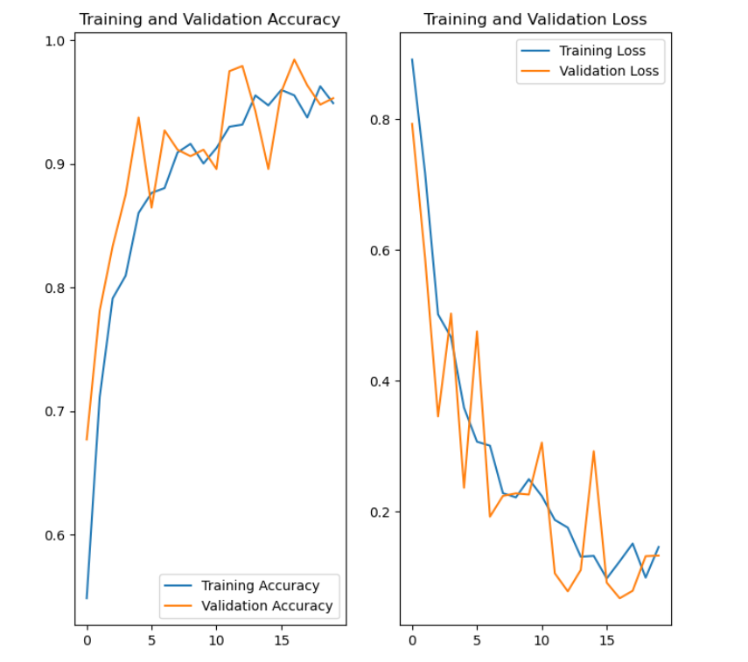
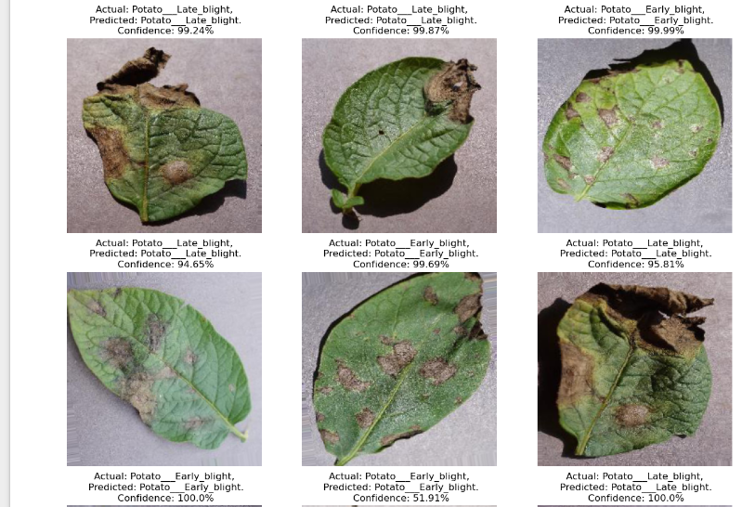
RESULT:-
Interface:-
Graph of Training And Validation (Accuracy & Loss):-
Model Testing on Sample Images:

Slide 10
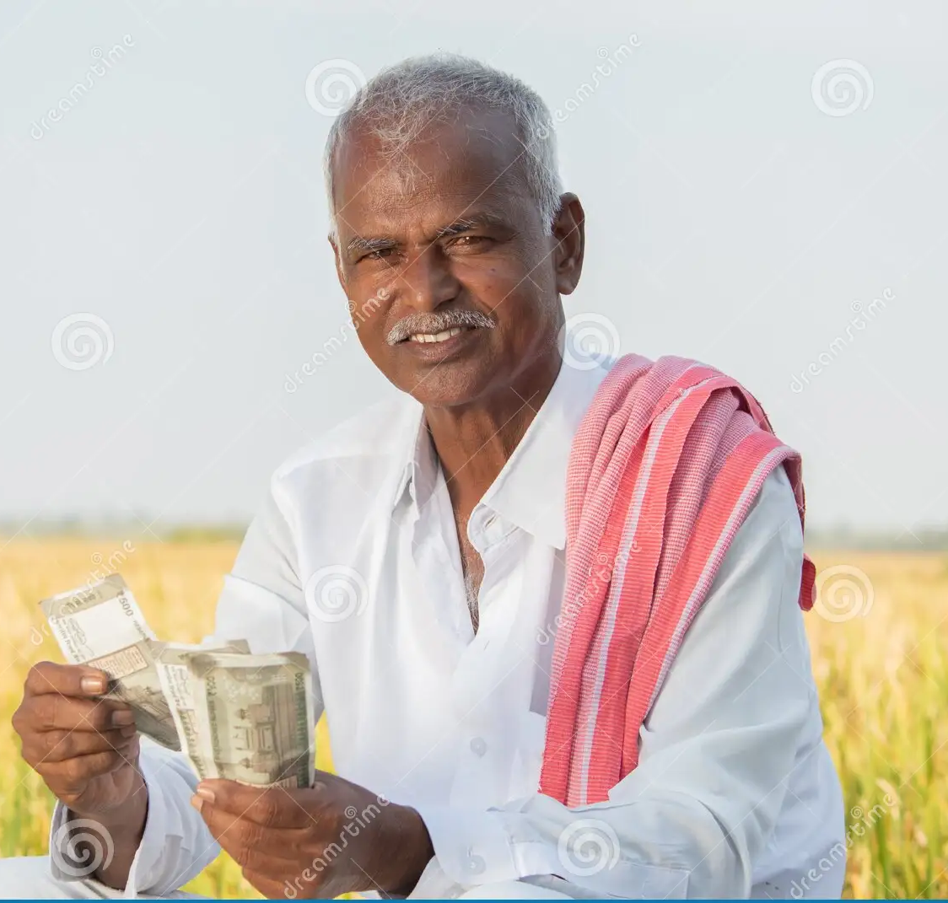
Conclusion and Future Directions
This presentation highlights the potential of CNNs for accurate and efficient crop disease prediction. This technology empowers farmers to make informed decisions and promote sustainable agricultural practices.
1
Improved Accuracy
2
Real-Time Monitoring
We will continue to improve the model's accuracy by collecting more data and refining the architecture.
Integrating the system with IoT sensors will allow for continuous monitoring and early detection of disease outbreaks.
3
Disease Management Recommendations
Expanding the system to provide personalized disease management recommendations based on the prediction results.

